Slide 1
Data preprocessing
Converting the raw data to a format that can easily be processed by our model
Raw data
Data cleaning
Data encoding
Preprocessed data
Feature selection/ dimensionality reduction
Data normalization

Slide 2
(1) Data cleaning
x1 | x2 | x3 | Target
1 | 2 | 3 | 1
? | 1 | 4 | 0
2 | 5 | 3 | 1
1 | ? | 2 | 1
2 | ? | 1 | 0
3 | 1 | 0 | 1
8 | 2 | 7 | 0
Removing undesired data (such as rows with missing values)
Another way to handle missing values is to replace them by column mean

Slide 3
(2) Data encoding
country | gender | x3 | Target
Egypt | Male | 3 | Negative
US | Female | 4 | Positive
Germany | Male | 3 | Positive
UK | Female | 2 | Negative
US | Female | 1 | Positive
Egypt | Male | 0 | Negative
France | Male | 7 | Negative
Most of machine learning models require numerical input and output
Features with categorical values (nominal values) must be converted to (encoded as) numerical features.
Target must also be converted to numerical value

Slide 4
(2) Data encoding
country | gender | x3 | Target
Egypt | 0 | 3 | 0
US | 1 | 4 | 1
Germany | 0 | 3 | 1
UK | 1 | 2 | 0
US | 1 | 1 | 1
Egypt | 0 | 0 | 0
France | 0 | 7 | 0
For binary features/outputs we can use 0 and 1
For gender: 0 for male, 1 for female
For target: 0 for negative, 1 for positive

Slide 5
(2) Data encoding
country | gender | x3 | Target
0 | 0 | 3 | 0
1 | 1 | 4 | 1
2 | 0 | 3 | 1
3 | 1 | 2 | 0
1 | 1 | 1 | 1
0 | 0 | 0 | 0
4 | 0 | 7 | 0
For features with more than 2 values, we can encode each value using a number
Example: For country:
0 = Egypt
1 = US
2 = Germany
3 = UK
4 = France

Slide 6
(2) Data encoding
Or we can use one-hot encoding
Country-Egypt | Country-US | Country-Germany | Country-UK | Country-France | Gender | x3 | Target
1 | 0 | 0 | 0 | 0 | 0 | 3 | 0
0 | 1 | 0 | 0 | 0 | 1 | 4 | 1
0 | 0 | 1 | 0 | 0 | 0 | 3 | 1
0 | 0 | 0 | 1 | 0 | 1 | 2 | 0
0 | 1 | 0 | 0 | 0 | 1 | 1 | 1
1 | 0 | 0 | 0 | 0 | 0 | 0 | 0
0 | 0 | 0 | 0 | 1 | 0 | 7 | 0

Slide 7

(3) Data normalization
Min = 0 |  | Max = 1000000
If features have very different ranges
Example: if x1 has range 0-10 while x2 has range 0-1000000
We should normalize the features (make them have the same range)
For example: The following formula will make any feature have the range 0-1
Normalization
Min = 0 |  | Max = 1
$$X_{new}=\frac{X_{old}−X_{min}}{X_{max}−X_{min}}$$

Slide 8
(4) Feature selection / dimensionality reduction
x1 | x2 | x3 | x4 | x5
If you have a large number of features, you can reduce their number using either:
Feature selection: Selecting the most important features and dropping the less important ones
Dimensionality reduction: Calculating new features from the original ones such that the number of new features is small.
Feature Selection
x1 | x2 | x3 | x4 | x5
x1 | x2 | x3 | x4 | x5
Dimensionality Reduction
z1 | z2 | z3

Slide 9
Preprocessed data
After preprocessing, we can easily use the preprocessed data to train our model
Raw data
Data cleaning
Data encoding
Preprocessed data
Feature selection/ dimensionality reduction
Data normalization

Slide 10
Evaluation Metrics
Regression

Slide 11
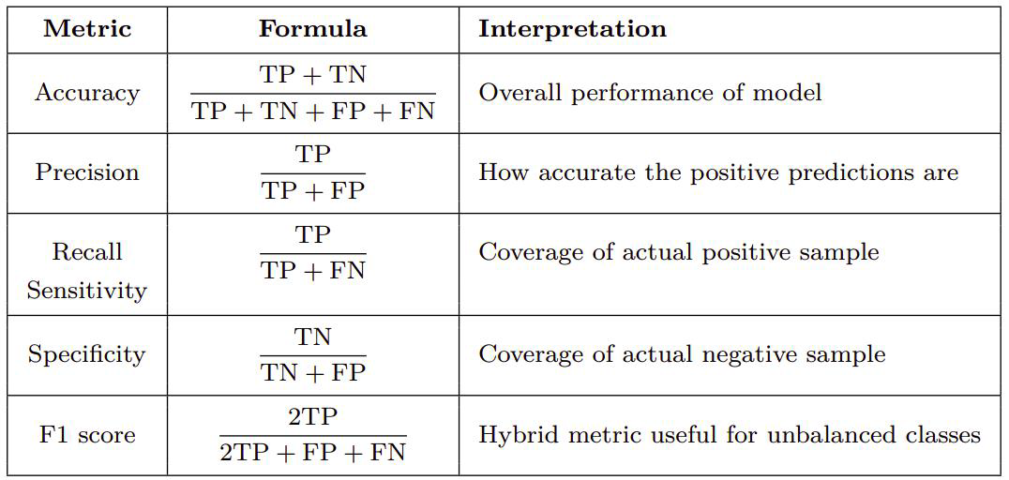
Evaluation Metrics
Classification
Confusion Matrix

Slide 12
Overfitting And Underfitting

